Slide 1
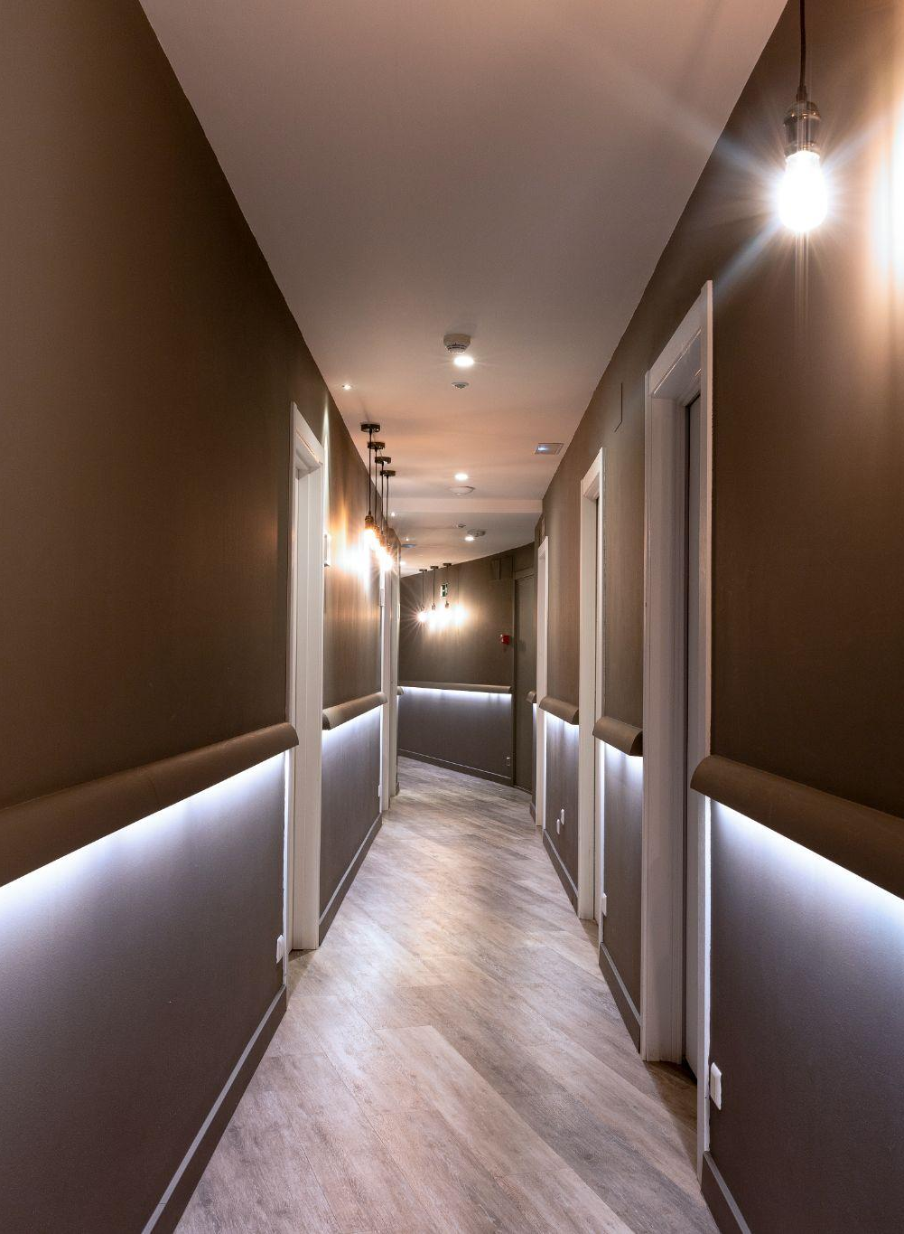
DATA STRUCTURE INDIVIDUAL PROJECT (HOTEL MANAGEMENT SYSTEM)
2023
HOTEL
PREPARED BY :
NAME : GOHEL HARDIK
ROLL NO. :206
DIV :7
ENROLL : 22002170110036
HOTEL MANAGEMENT SYSTEM
DS PROJECT

Slide 2

INTRODUCTION
2023
2023
"Welcome to our Hotel Management System project powered by Data Structure using Java, where modern technology meets hospitality. With seamless room booking, check-in, and check-out processes, we're here to revolutionize your hotel experience."
HOTEL MANAGEMENT SYSTEM
HOTEL MANAGEMENT SYSTEM
—Introduction
DS PROJECT
DS PROJECT

Slide 3
MAIN OBJECTIVES OF THE PROJECT
2023
Effortless Check-In: "Streamlined check-in for a swift arrival experience."
Seamless Check-Out: "Hassle-free check-out, right from your room."
Real-time Room Availability: "Instantly know which rooms are ready to welcome you."
Occupancy Status at a Glance: "Stay informed with real-time room occupancy updates."
Effortless Exit: "Bid farewell with ease and fond memories."
HOTEL MANAGEMENT SYSTEM
DS PROJECT

Slide 4
FUNCTIONS
2023
01
02
03
04
HOTEL MANAGEMENT SYSTEM
CHECK-IN
CHECK-OUT
AVAILABLE ROOMS
OCCUPIED ROOMS
DS PROJECT

Slide 5
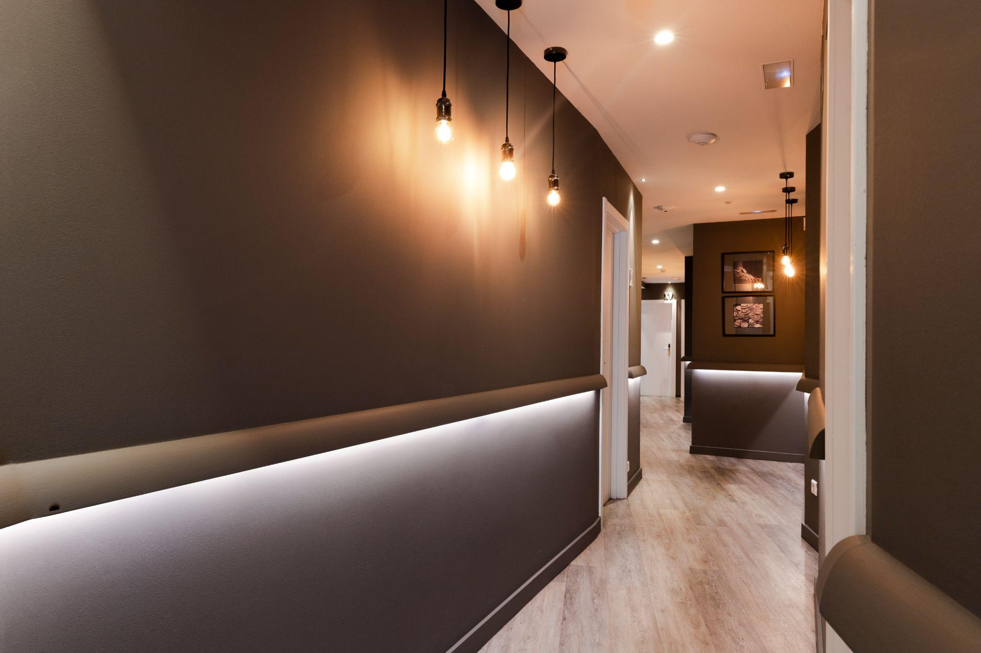
SECTION 1
01
2023
ROOM CHECK-IN
"Upon arrival, guests provide their preferred room number from the available list. Subsequently, essential details including their name, valid ID proof, and contact information are collected and securely stored in our system's linked list.Once completed, a prompt message confirms their successful room check-in, ensuring a smooth and hassle-free start to their stay."
HOTEL
HOTEL MANAGEMENT SYSTEM
DS PROJECT
HOTEL

Slide 6

SECTION 2
02
2023
ROOM CHECK-OUT
"During check-out, guests specify their room number for processing. Depending on whether they have opted for a daily rate or an hourly rate, the system generates the bill accordingly, considering the total number of days or hours they stayed. This streamlined check-out process ensures an accurate and efficient settlement of charges for their stay."
HOTEL
HOTEL MANAGEMENT
VIEWS
DS PROJECT

Slide 7

03
SECTION 3
2023
VIEW AVAILABLE ROOMS AND OCCUPIED ROOMS
Planning your stay has never been easier. With our Hotel Management System, you can effortlessly view both available and occupied rooms in real-time. Find your ideal sanctuary among the available options or gain insight into the heartbeat of our hotel by checking the occupied rooms.
HOTEL
HOTEL MANAGEMENT
VIEWS
DS PROJECT

Slide 8

04
EXIT
2023
RELAX
HOTEL MANAGEMENT
DS PROJECT

Slide 9


THANKS!
THANKS!
2023
DS PROJECT
HOTEL MANAGEMENT SYSTEM
DS PROJECT

